Slide 1



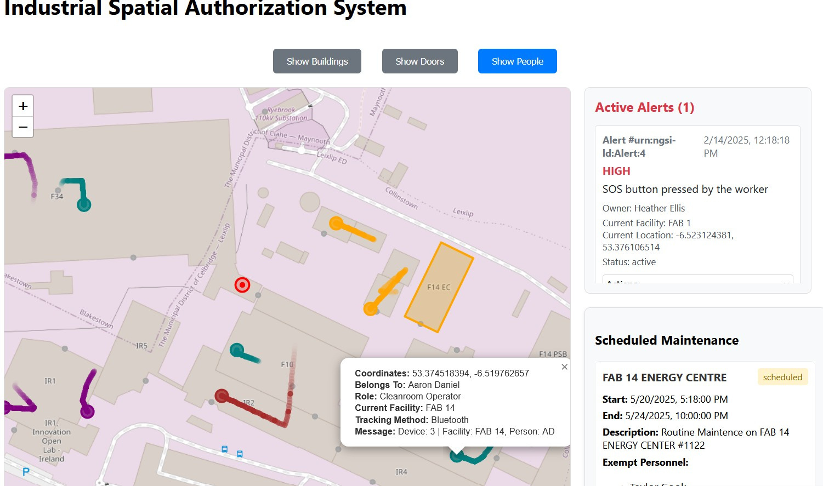

INDUSTRIAL SPATIAL AUTHORIZATION
Smart Access and Security Management for Industrial Facilities
University of Patras 2024-2025
Kosmas Archontis
Maria Aspioti

Slide 2

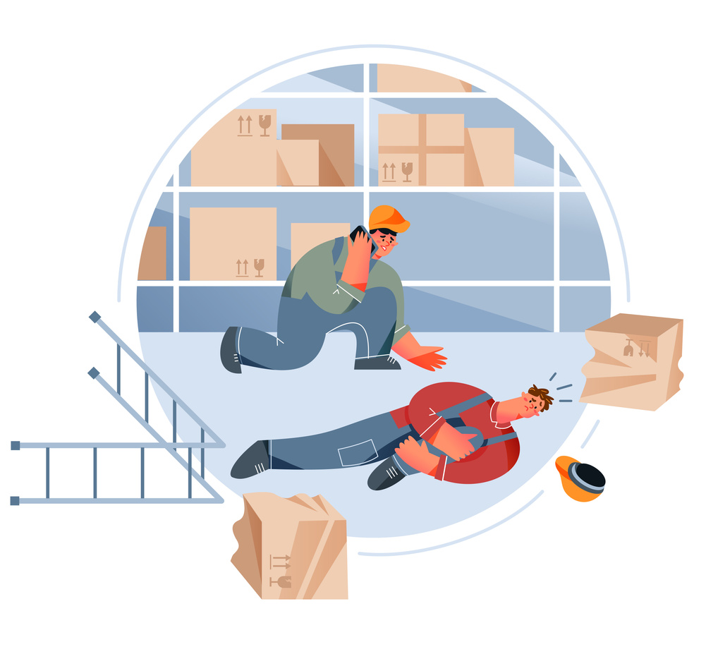
What Makes Industrial Spaces Difficult to Manage?
Real-Time Tracking?
Industrial environments are large and complex. Tracking movement and proper access is vital to worker safety, but difficult to do for every individual employee.
Emergency Alert Response?
Environmental Controls?
In critical environments, incidents escalate quickly. A fast, reliable alert system is needed to ensure help arrives without delay.
Sensitive zones in manufacturing plants and industrial complexes are common, and require strict environmental control to protect vital processes and equipment.

Slide 3
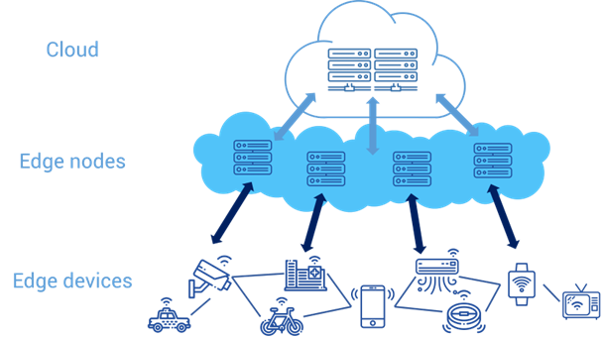
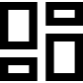


Why the Internet of Things (IoT)?
The Internet of Things (IoT) connects physical devices - like sensors, locks, and buttons - to the network, enabling real-time monitoring, control, and automation, all from a remote dashboard.
Smart Homes, Smart Cities, Smart Campus, ...
Devices collect data, send it to the cloud, and trigger real-time actions. For example, environmental data show low temp., turn on AC.
ISAS is an IoT system that tackles security and access management problems in industrial environments - Smart Facilities.

Slide 4




Project Background
December
February
This was a semester-long project for the undergraduate course “Internet of Things“. We assumed the role of a startup company, with it’s first project related to covering security needs of industries
Flesh out specifics
Create ideal architecture and to be implemented
Start developing
Further enhance functionalities and features
Present usable dashboard
Milestone 1
Initial Pitch. Explore concept, develop the idea in depth, figure out system functionalities. Dream big.
Explore idea
Decide on scenario
Determine system capabilities
Create core software features
Integrate real devices
Basic functionality
Milestone 2
Fully develop the system architecture. Decide on the tech for each section, decide what will be fully implemented
November
January
Milestone 3 - Final
Implement the parts of the system as decided in Milestone 2. Present final work.
Team 6 - 2025

Slide 5

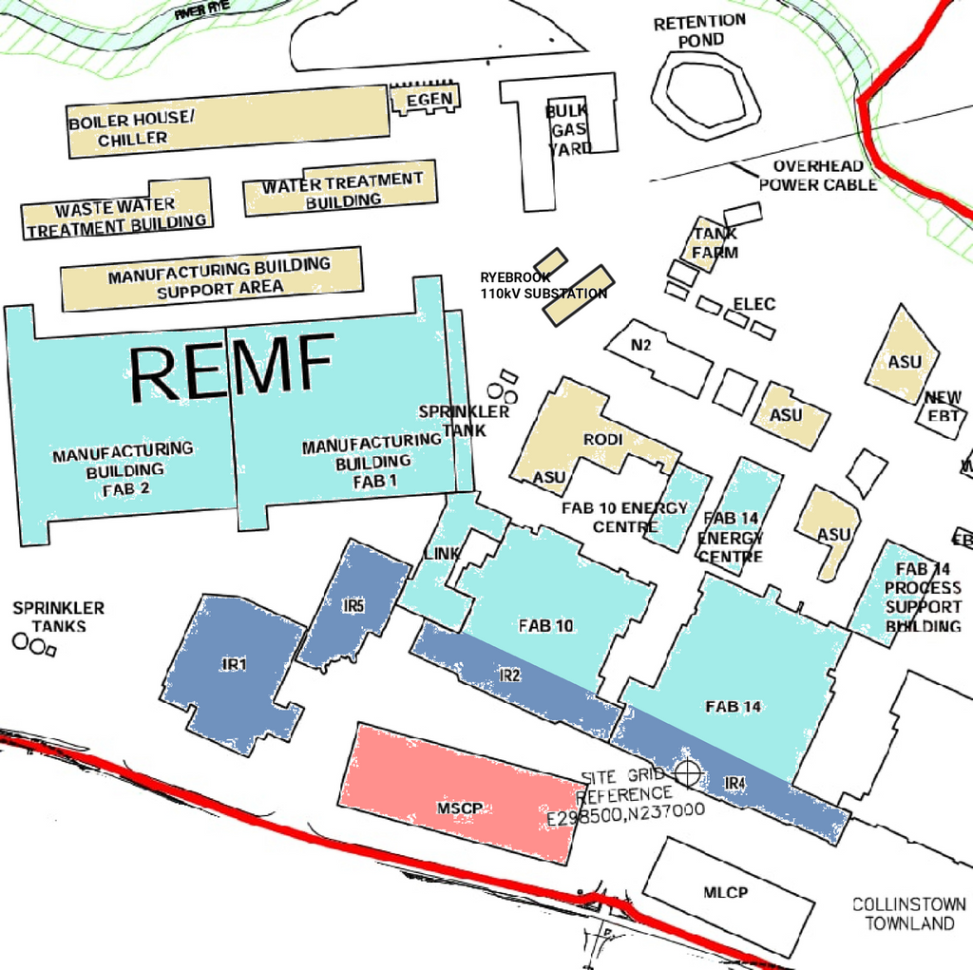

A Case Study
Scenario: Intel’s Chip Fabrication Plant in Leixlip, Ireland
Cleanrooms, R&D
Manufacturing Buildings
Energy Centers, Water Treatment Buildings
Offices

Slide 6
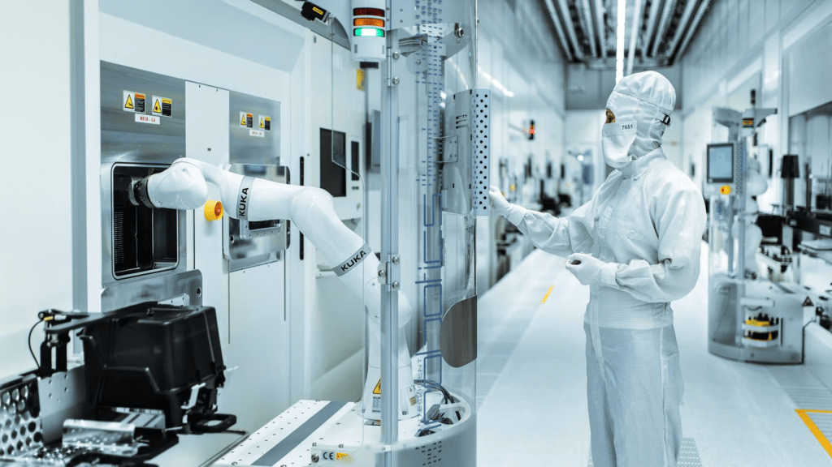






System Requirements
To address the operational and security needs of a system set in Intel’s chip fab in Leixlip, ISAS should meet the following key requirements.
Real-time worker tracking and movement history
Recognize incidents and generate related Alerts
Role-based Access Control & detailed Room Access log
Dynamic Environmental Awareness
Facility Scheduling and Maintenance
Emergencies & Evacuation Paths

Slide 7


Current Capabilities & Implementation
BT-indoors, GPS-outdoors Tracking
Over the course of the semester, we managed to develop a large part of the envisioned system, while others remain to be implemented.
Per-worker Historic Movement View
Smart Lock Doors with NFC Readers
Wearable SOS Button
Camera-rigged Cleanrooms
Environmental Monitoring
Evacuation Pathfinding
Complete Dashboard

Slide 8
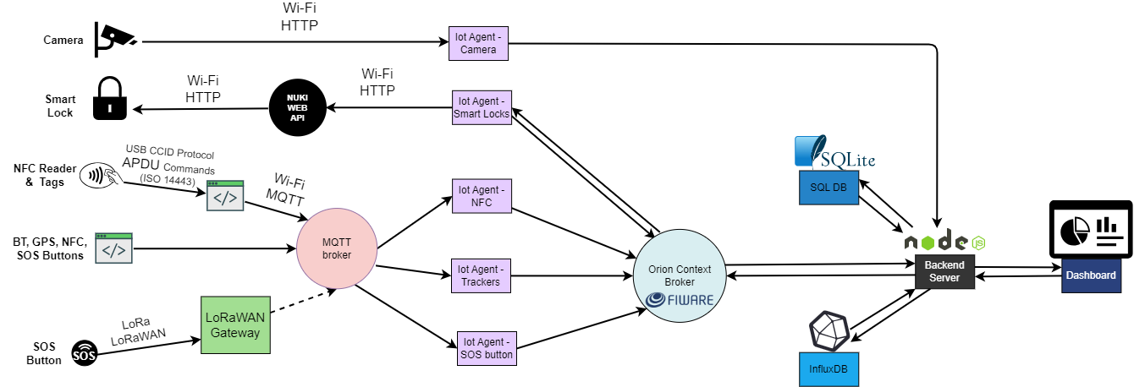
System Architecture

Slide 9



VIDEO SHOWCASE
www.reallygreatsite.com

Slide 10
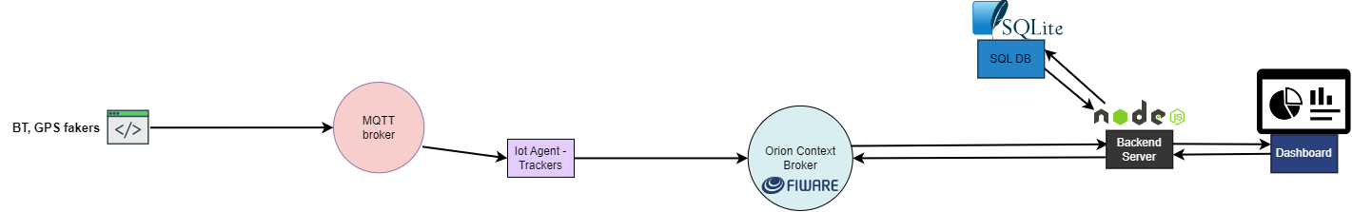
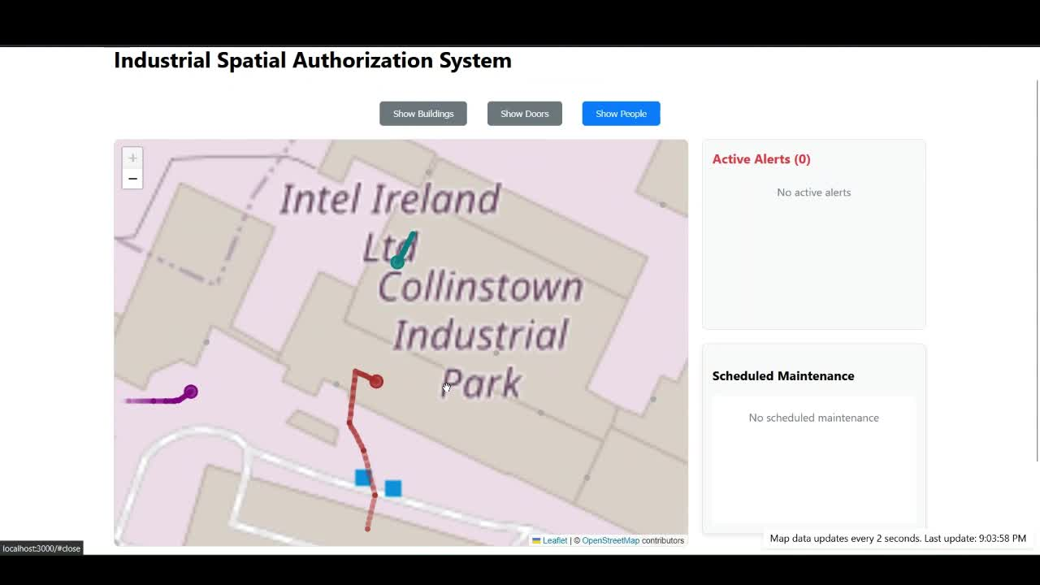
Worker Tracking

Slide 11
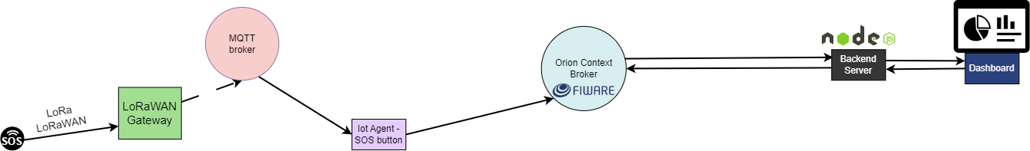
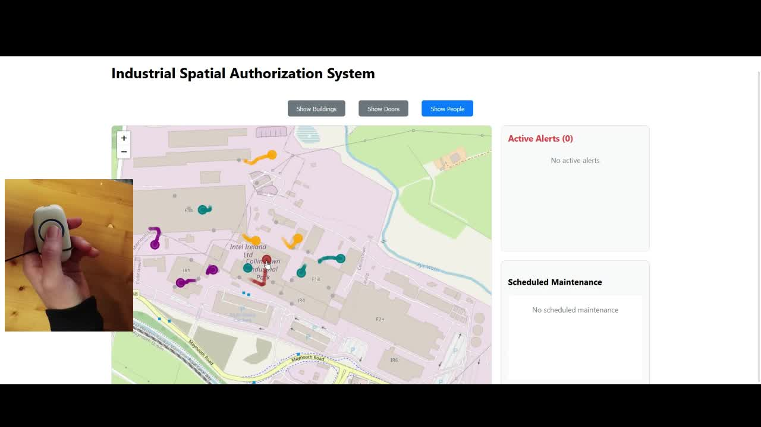
SOS Button - Alert in Dashboard

Slide 12
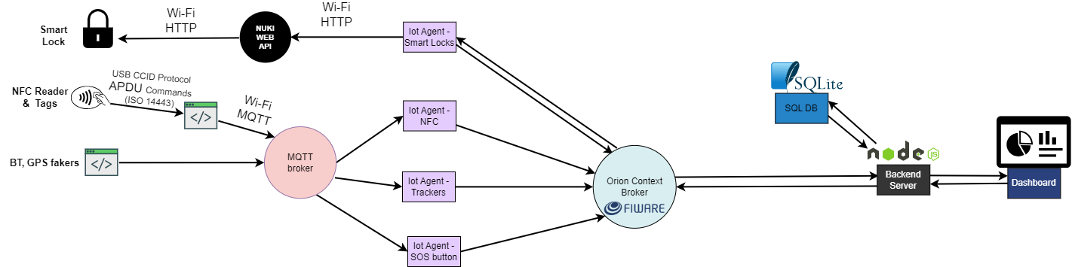
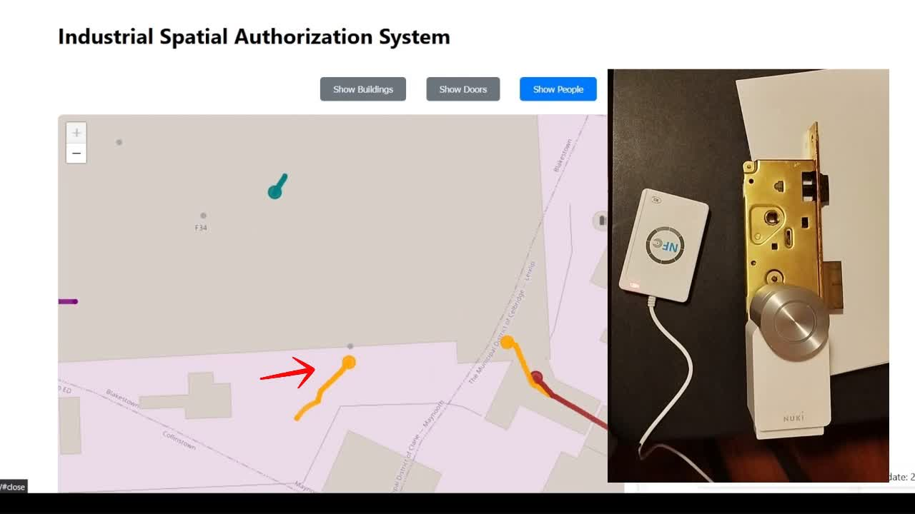
Access Control

Slide 13
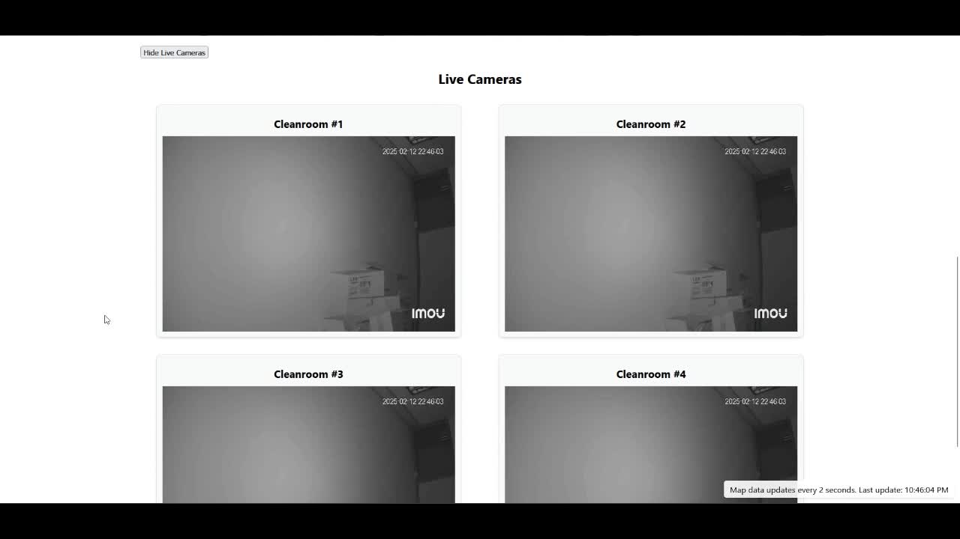
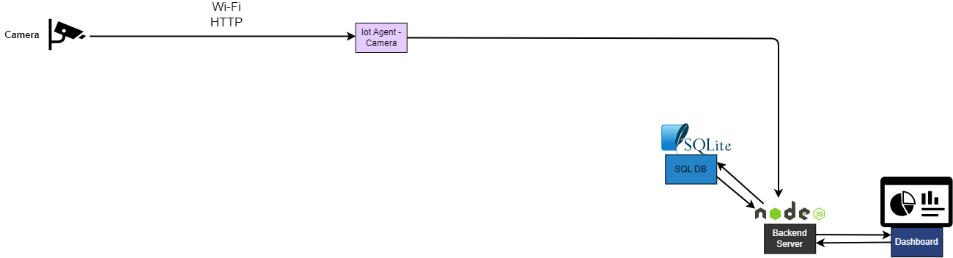
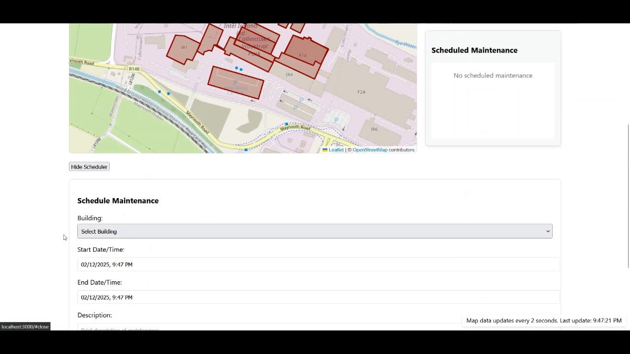
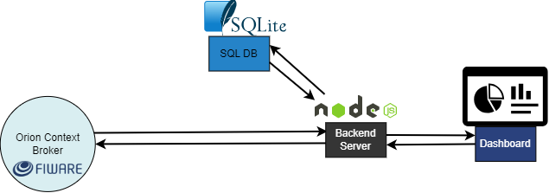
Camera Feed - Maintenances

Slide 14
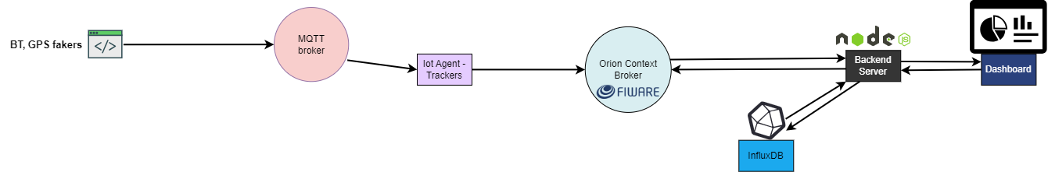
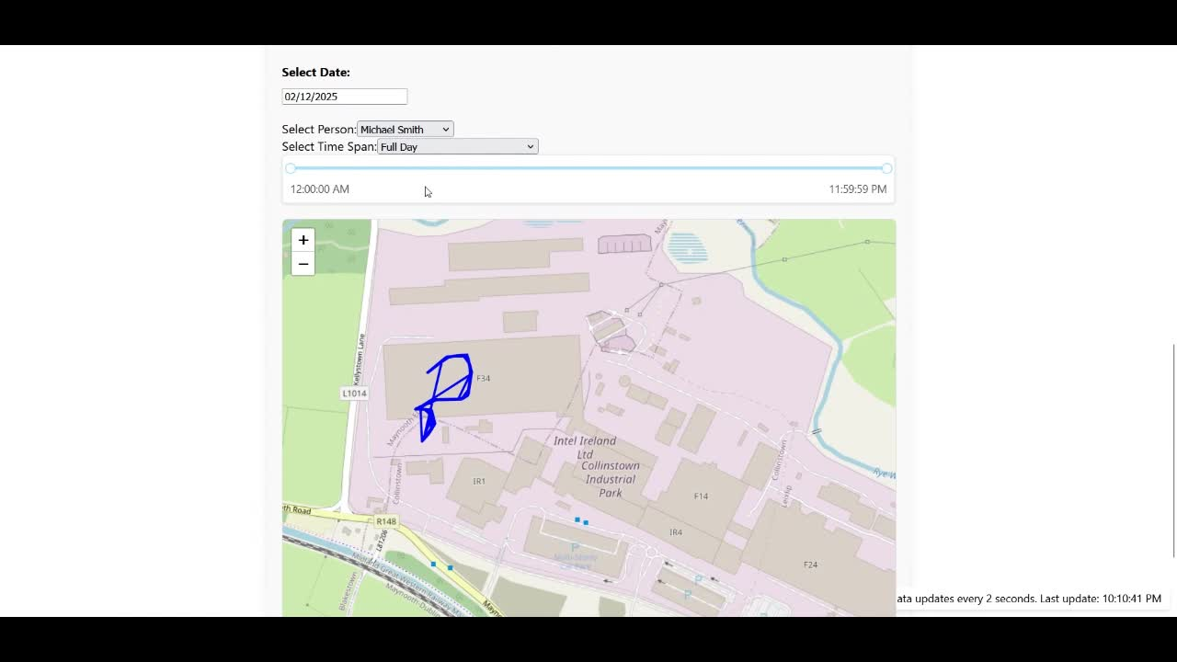
Historic View – Worker Past Locations

Slide 15


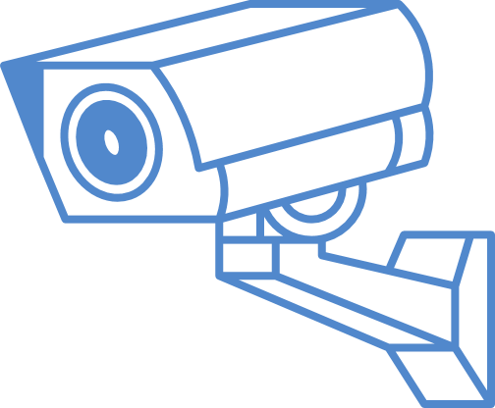

Future Work
AI integration for detecting anomalous behavior/accesses?
Computer Vision for ensuring proper Cleanroom suit protocol?
Crowding insight and analytics of facilities?

Slide 16

THANK YOU!
Κοσμάς Αρχοντής
Μαρία Ασπιώτη
Πανεπιστήμιο Πατρών
Ηλεκτρολόγων Μηχανικών & Τεχνολογίας Υπολογιστών
5ο Έτος
Πανεπιστήμιο Πατρών
Ηλεκτρολόγων Μηχανικών & Τεχνολογίας Υπολογιστών
5ο Έτος
GitHub:
https://github.com/mariaaspioti/IoT-ISAS.git

